Slide 1
THERMOMETER
Group D

Slide 2
INDEX
Introduction
Block Diagrams
Temperature Sensors Interface
Control Unit
LCD Interface
Humidity Sensor

Slide 3
INTRODUCTION
Expected system’s behaviour:
Measurement of temperature
Temperature processing
Comparison with registered values
Printing on LCD

Slide 4
INTRODUCTION: Working steps
04
Put in common
Upload to Github
01
03
VHDL code
Debugging
02

Slide 5
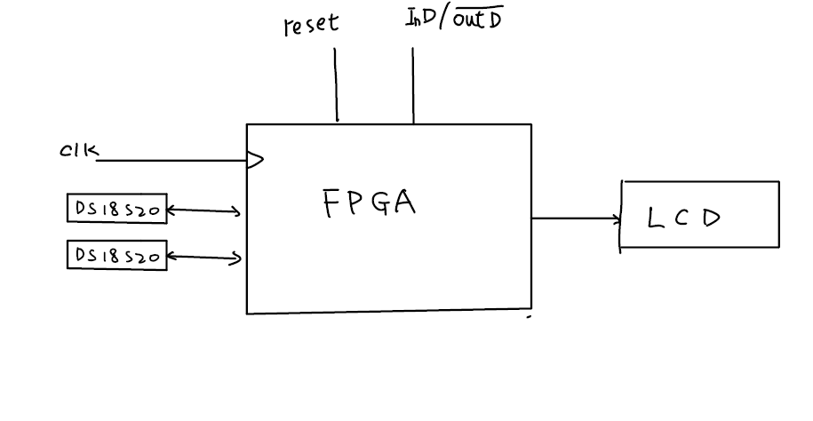
Initial Block Diagram

Slide 6
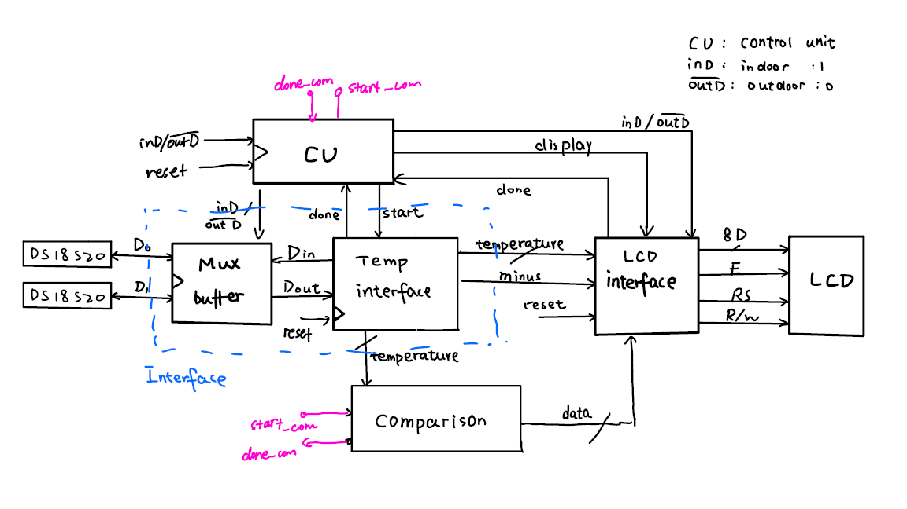
Deeper view Block Diagram

Slide 7
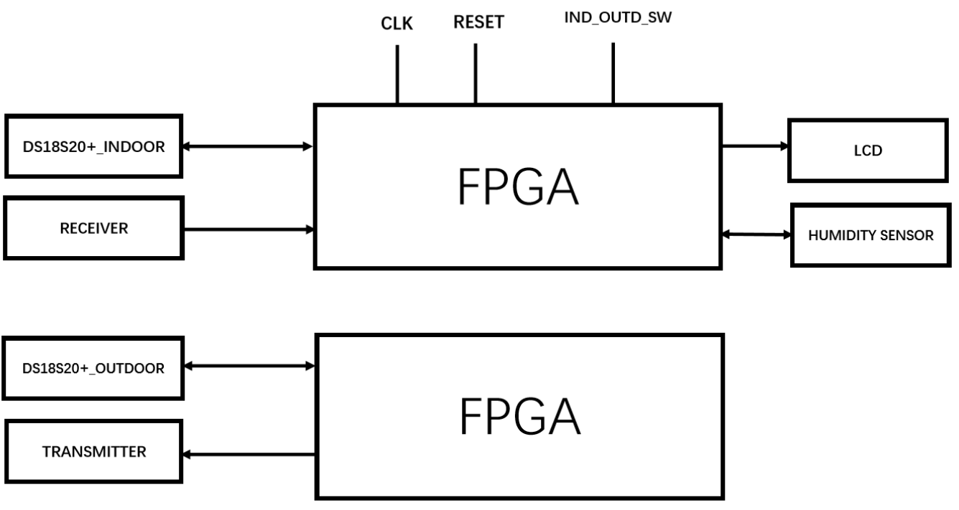
Updated Design

Slide 8
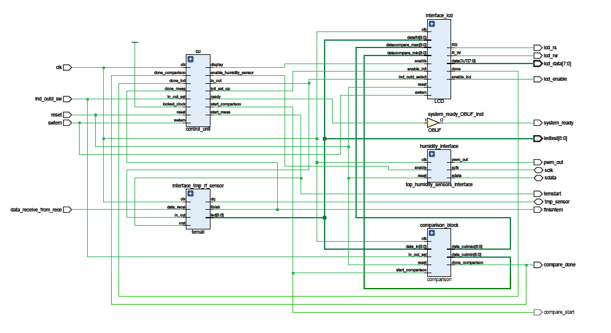
RTL View

Slide 9
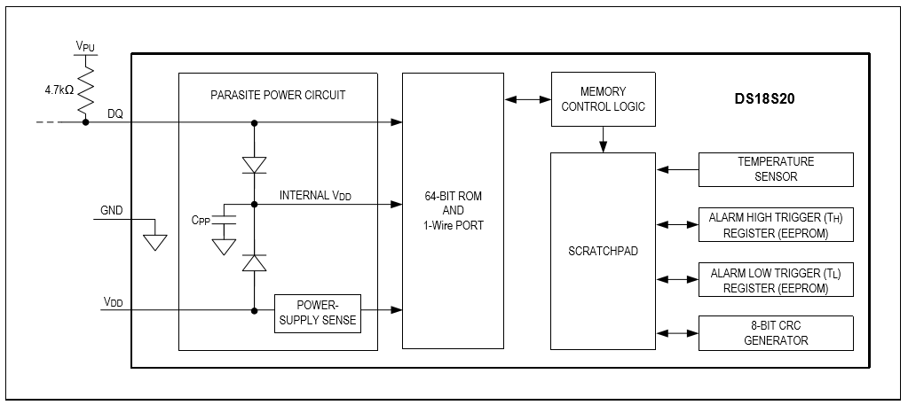
Internal structure of temperature sensor
Notes:
It contains 2 main parts, one is 64bit ROM which stores a unique serial number of each temperature sensor, we need the serial number to choose which one works, another is scratchpad.

Slide 10
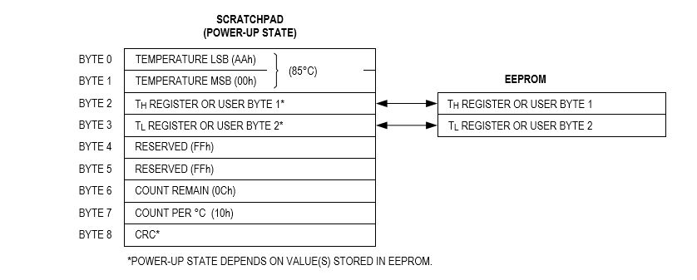
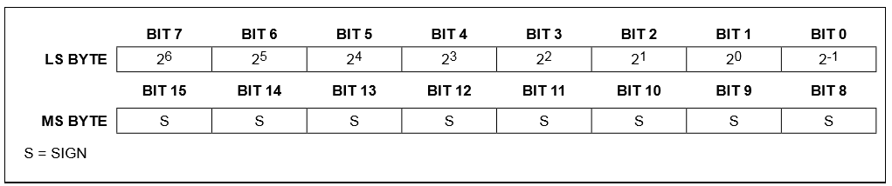
Scratchpad
Temperature format
Notes:
We only need 9 bits for our temperature value

Slide 11
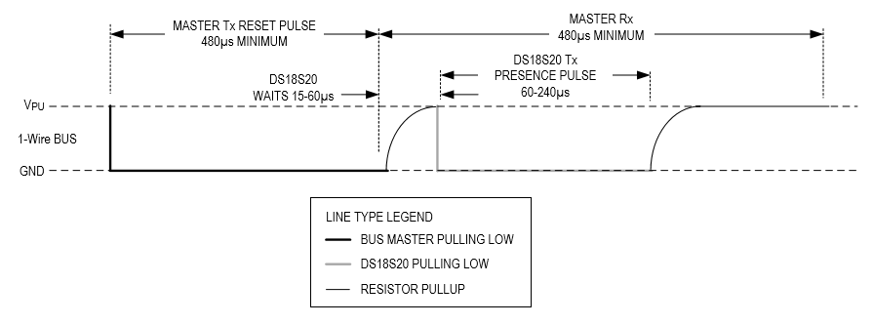
Initialization
Notes:
The initialization of temperature sensors. First the master, or in other words, the FPGA will send a reset pulse to the TS.

Slide 12
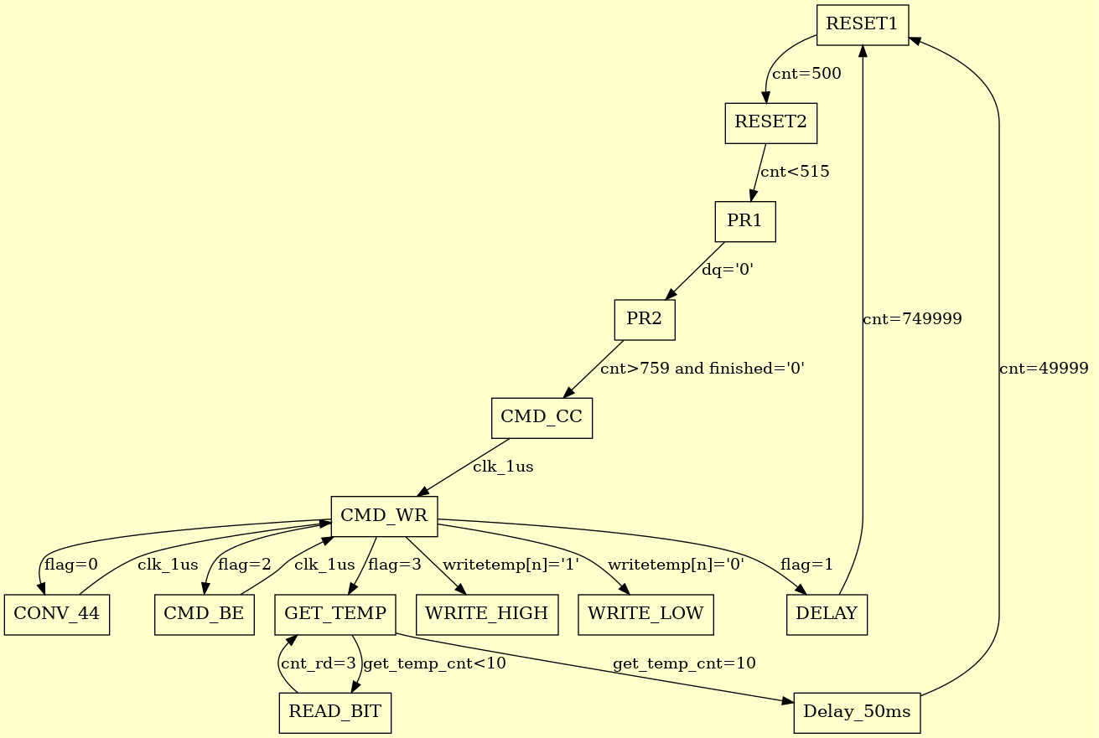
DS18S20+
Notes:
millisecond

Slide 13
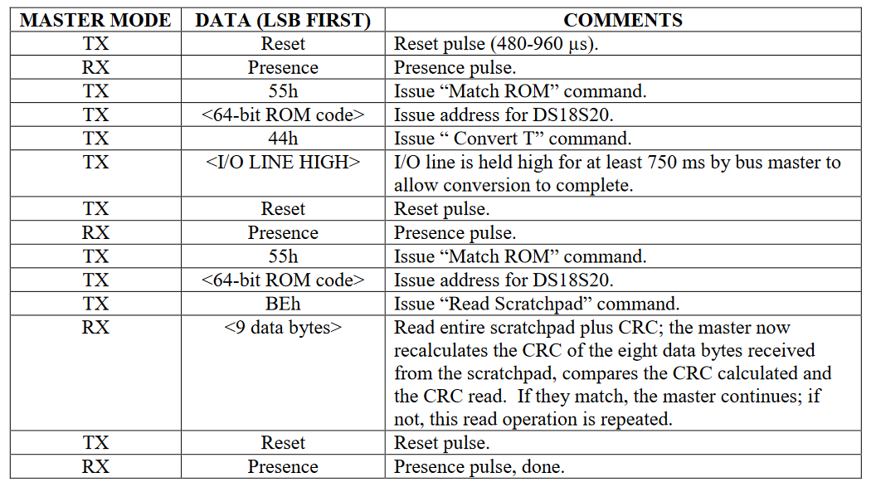
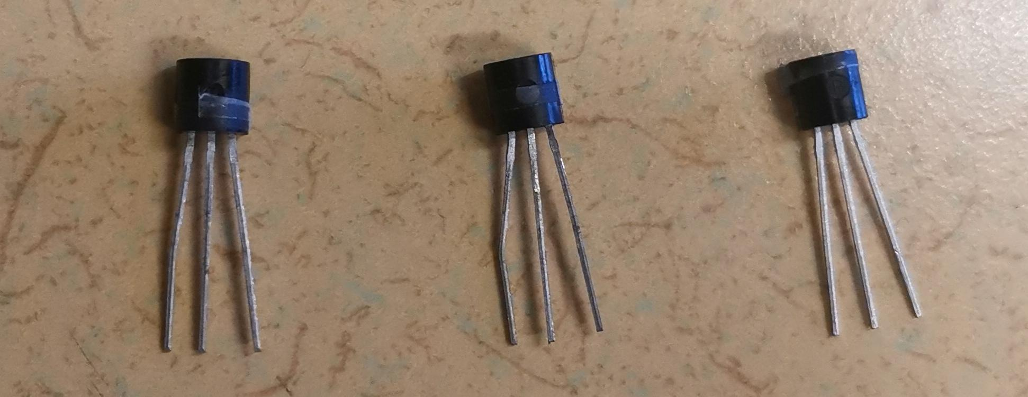
1111011000000000000010000000001110011011010101110101000000010000
1001001000000000000010000000001110011011100111011100110100010000
0011001100000000000010000000001110011011010110101011000000010000

Slide 14
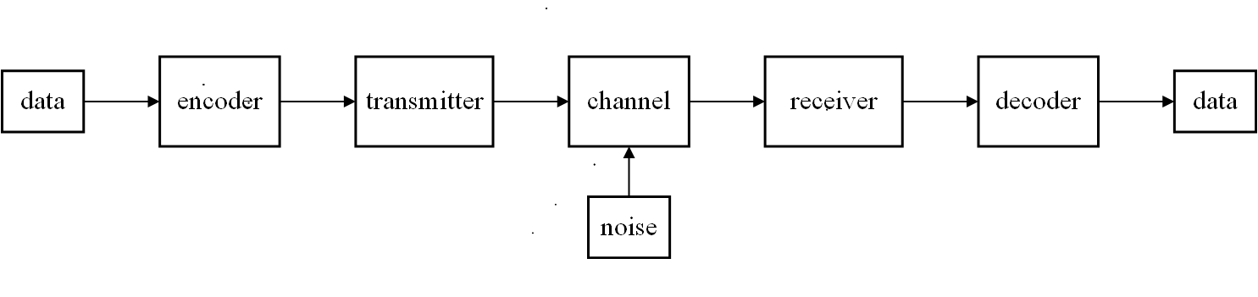
The block diagram of RF transmission
Notes:
Complete transmission
More suitable signal for transmission

Slide 15
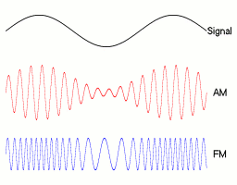
Receiver
Selection
Amplification
Demodulation
Transmitter
Modulation
Amplification
Notes:
Control one parameter of
Converted into electromagnetic wave

Slide 16
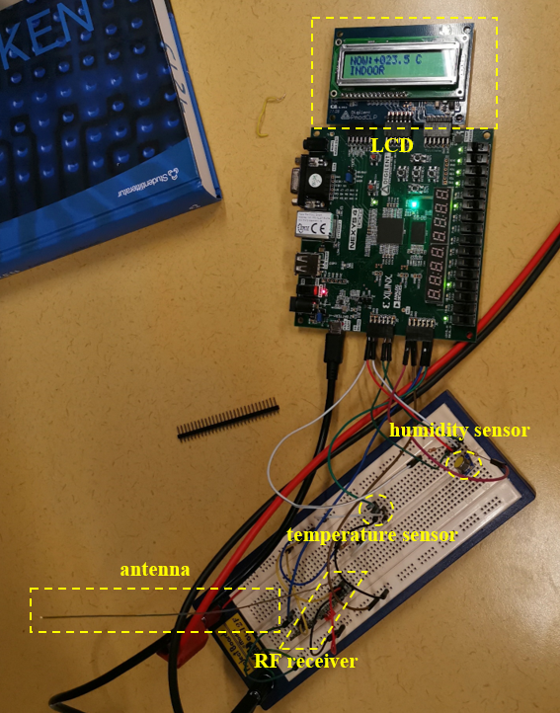
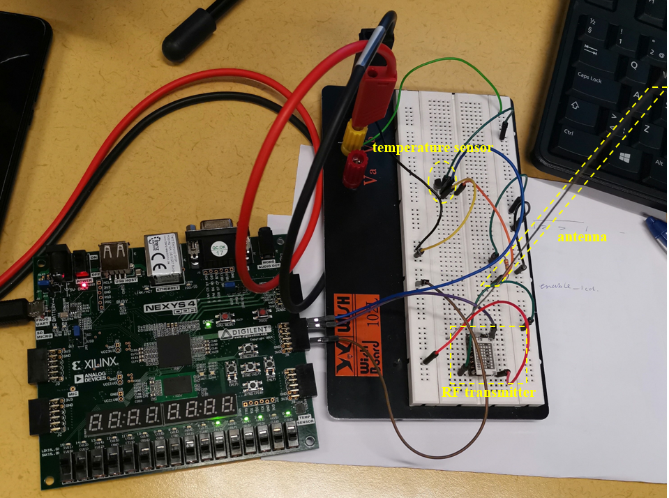
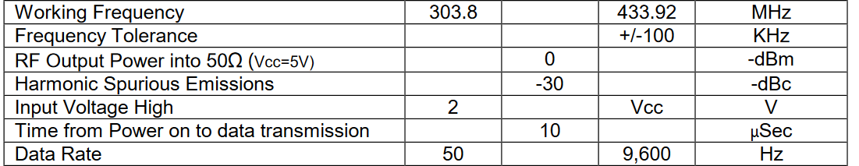
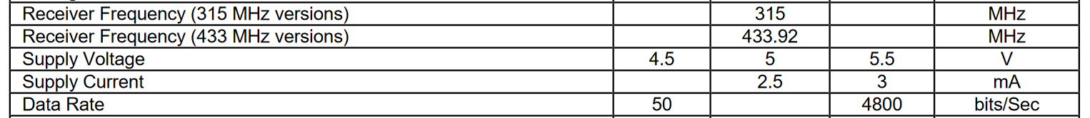
Notes:
Transmitter: 20 ms - 100 us 50-4800 Hz data rate
Receiver: 20 ms - 200 us 50-9600 Hz data rate
OUR: 4ms 250HZ

Slide 17
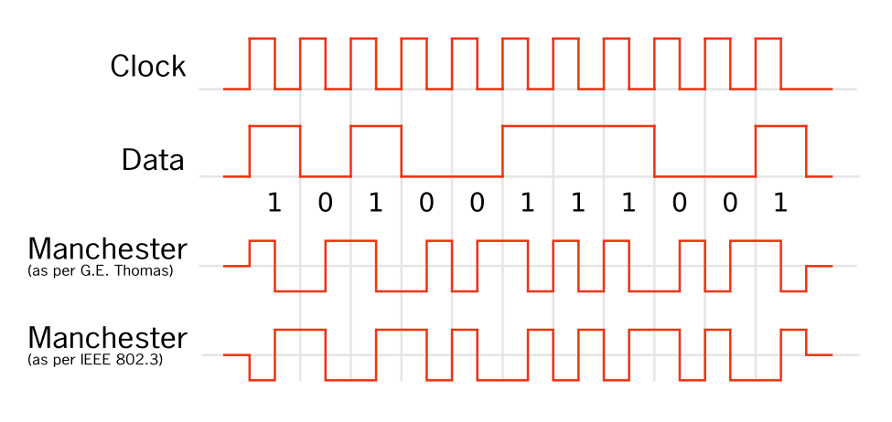
Encode & decode
Start sequence:
000111110
Rising edge: bit 0
Falling edge: bit 1

Slide 18
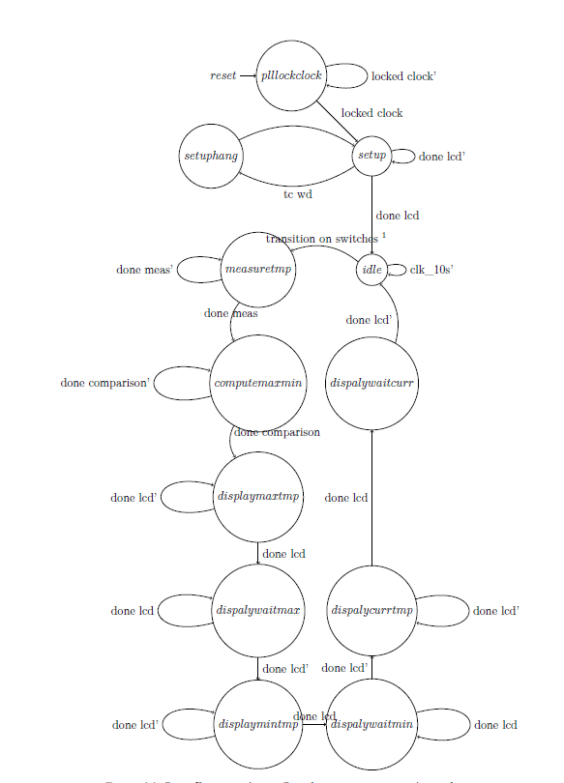
The brain of the IC,
the Control Unit
Moore FSM
In charge of scheduling the operations of interfaces
Recover from possible initialization LCD errors
Refresh the temperature in case of no actions from the user

Slide 19
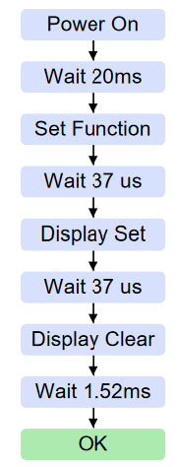
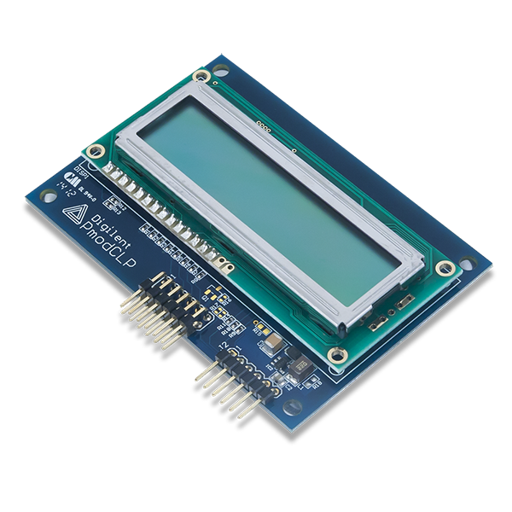
LCD INTERFACE
Initialization
DATA
FIXED
VARIABLE
ASCII TRANSLATOR

Slide 20
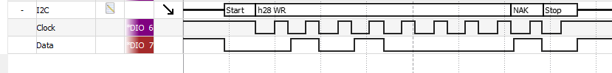
The humidity sensor, Sensor Interface
I2C protocol with one master and one slave
Read values used as duty cycle of a PWM

Slide 21
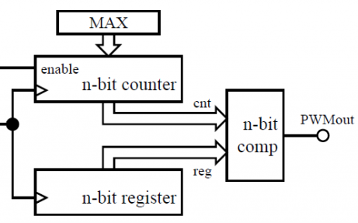
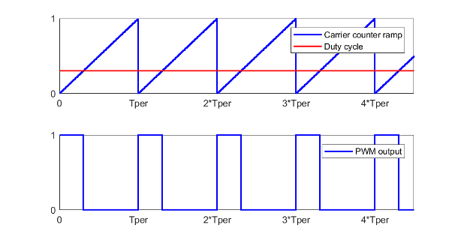
The humidity sensor, Pulse Width Modulation
According to:
fpwm = fclk/(MAX+1)
Duty Cycle = reg / (MAX+1)

Slide 22
And now…
Practical things
Let’s play with the components!

